Slide 1
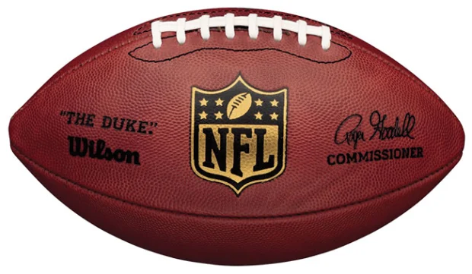
Who is the best Quarterback?
In the modern era (2000-2023)
IST 652 Final Project
Richard Sangster

Slide 2


Data Sources
NFL.com
- 50 Quarterbacks a year for 23 years (from 2000 to 2022)
- 1,150 rows/ observations
- 17 measured statistics per observation
- Overall season statistics
Twitter
- 5000 tweets from the last 3 years
- multiple searches

Slide 3
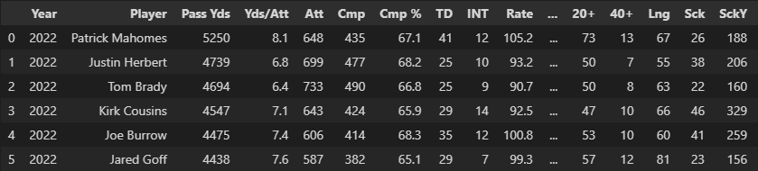
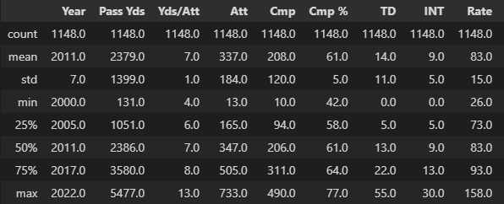
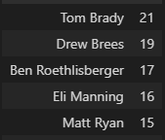
Data Cleaning and Viewing
NFL.com
Data came in decently clean
Put into Pandas Dataframe
Minimum stats are skewed because of
backup QB’s

Slide 4
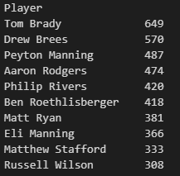
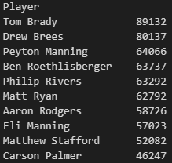
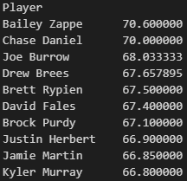
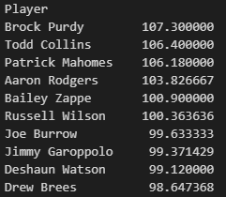
Checking Overall Stats
Overall sum of stats
- Years in the league skew the data
- Not a very good representation of the data
Overall average of stats
- Players who throw/play less can have high stats
- Not a very good representation of the data

Slide 5
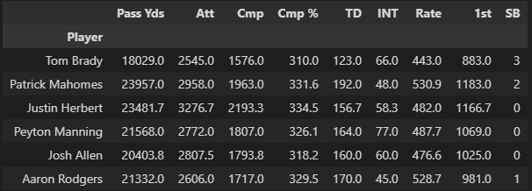
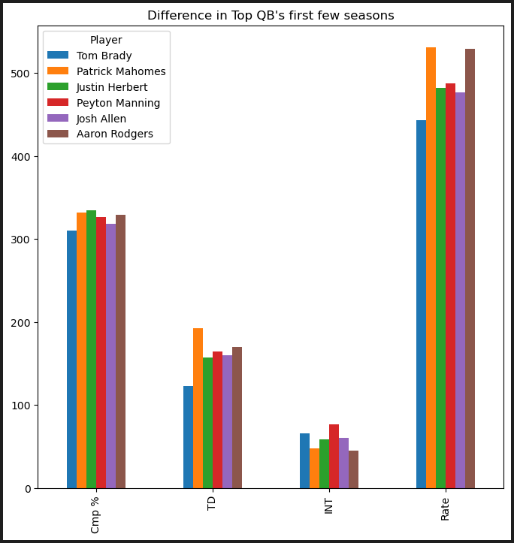
Well Known Top QB comparison
Team Old Timers
Tom Brady
Peyton Manning
Aaron Rodgers
New Guys
Patrick Mahomes
Justin Herbert*
Josh Allen*
Statistics from first 5 years in the league
Included is SB wins
*Extrapolated to 5 years

Slide 6
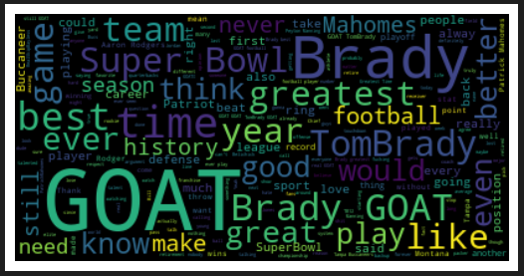
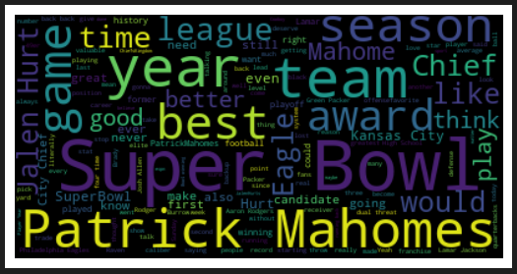
What the fans think (twitter at least)

Slide 7
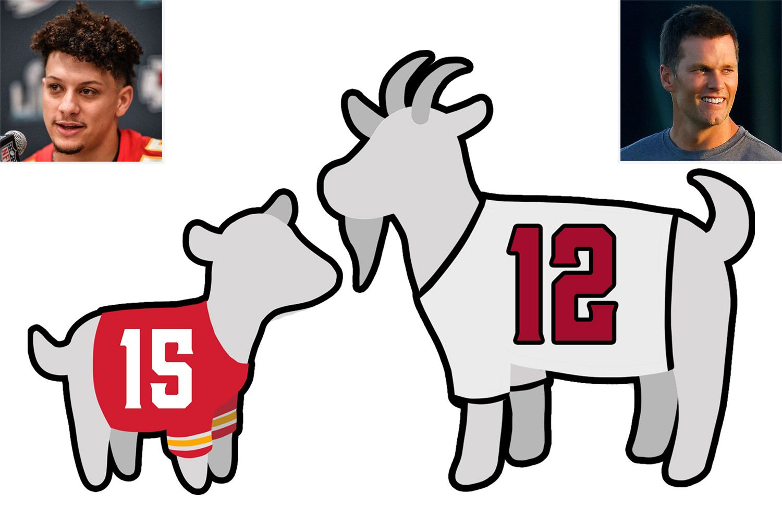
Conclusion – Tom Brady (for now)
Overall
- Tom Brady is the best quarterback from a stats line and by Super Bowl wins
Stand alone
- Mahomes has better stats year to year but is only just starting
- Mahomes has one of the best first 5 years as a starting QB
If Mahomes stays on this pace he will pass Tom’s passing record in his 19th season (TB - 23 seasons) and beat his TD record in his 17th season (TB -23 seasons)

